Slide 1

Microsoft PDC10 Keynote
Oleksandr Krakovetskyi
Senior Software Engineer at The Frayman Group
MCP, Microsoft Regional Director
October 30, Vinnitsya

Slide 2
Agenda
Local events
What’s new on Microsoft PDC10
Azure, Windows Phone 7, IE9 Preview 6
C# 5.0 & VB.NET direction

Slide 3
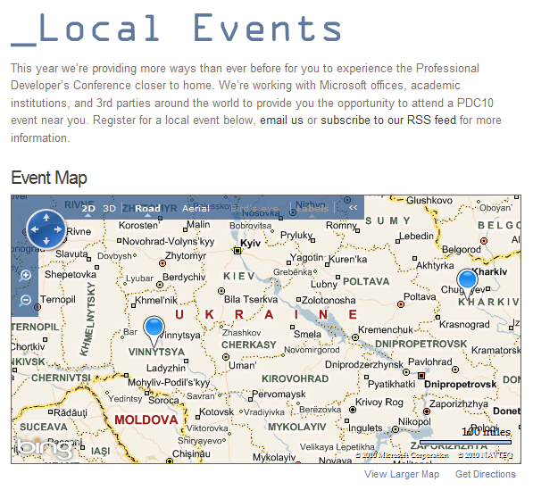
Microsoft PDC10 Local Events

Slide 4
Internet Explorer 9 Preview 6
New features:
CSS3 2D Transforms
HTML5 Semantic Element
HTMLElement
Facts:
10 billions of downloads (6 weeks)
Next version is RC and RTM
http://habrahabr.ru/blogs/ie/107117/
http://blogs.msdn.com/b/ie/archive/2010/10/28/html5-using-the-whole-pc-sixth-ie9-platform-preview-available-for-developers.aspx
http://windowsteamblog.com/ie/b/ie/archive/2010/10/28/ie9-beta-gathers-momentum-and-developers-get-platform-preview-6.aspx

Slide 5
Windows Azure
Pixar introduces Renderman – new cloud service based on Windows Azure
Windows Azure Virtual Machine Role
Server Application Virtualization
New cloud services
Extra Small Windows Azure Instance ($5/hour)
http://microgeek.ru/blogs/conf/860/

Slide 6

Windows Phone 7
“Programming Windows Phone 7” by Charles Petzold
This book is a gift from the Windows Phone 7 team at Microsoft to the programming community, and I am proud to have been a part of it. Within the pages that follow, I show you the basics of writing applications for Windows Phone 7 using the C# programming language with the Silverlight and XNA 2D frameworks.
http://blogs.msdn.com/b/microsoft_press/archive/2010/10/28/free-ebook-programming-windows-phone-7-by-charles-petzold.aspx

Slide 7
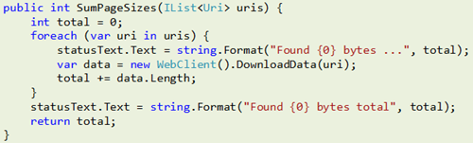
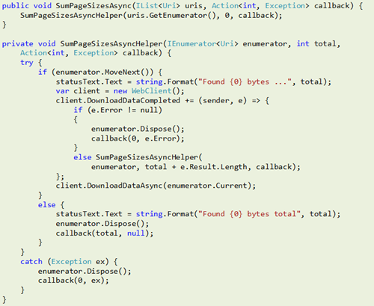
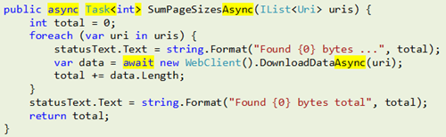
C# 5.0 - Asynchronous

Slide 8
Lets start!
akrakovetsky@fraymangroup.com

